Slide 1
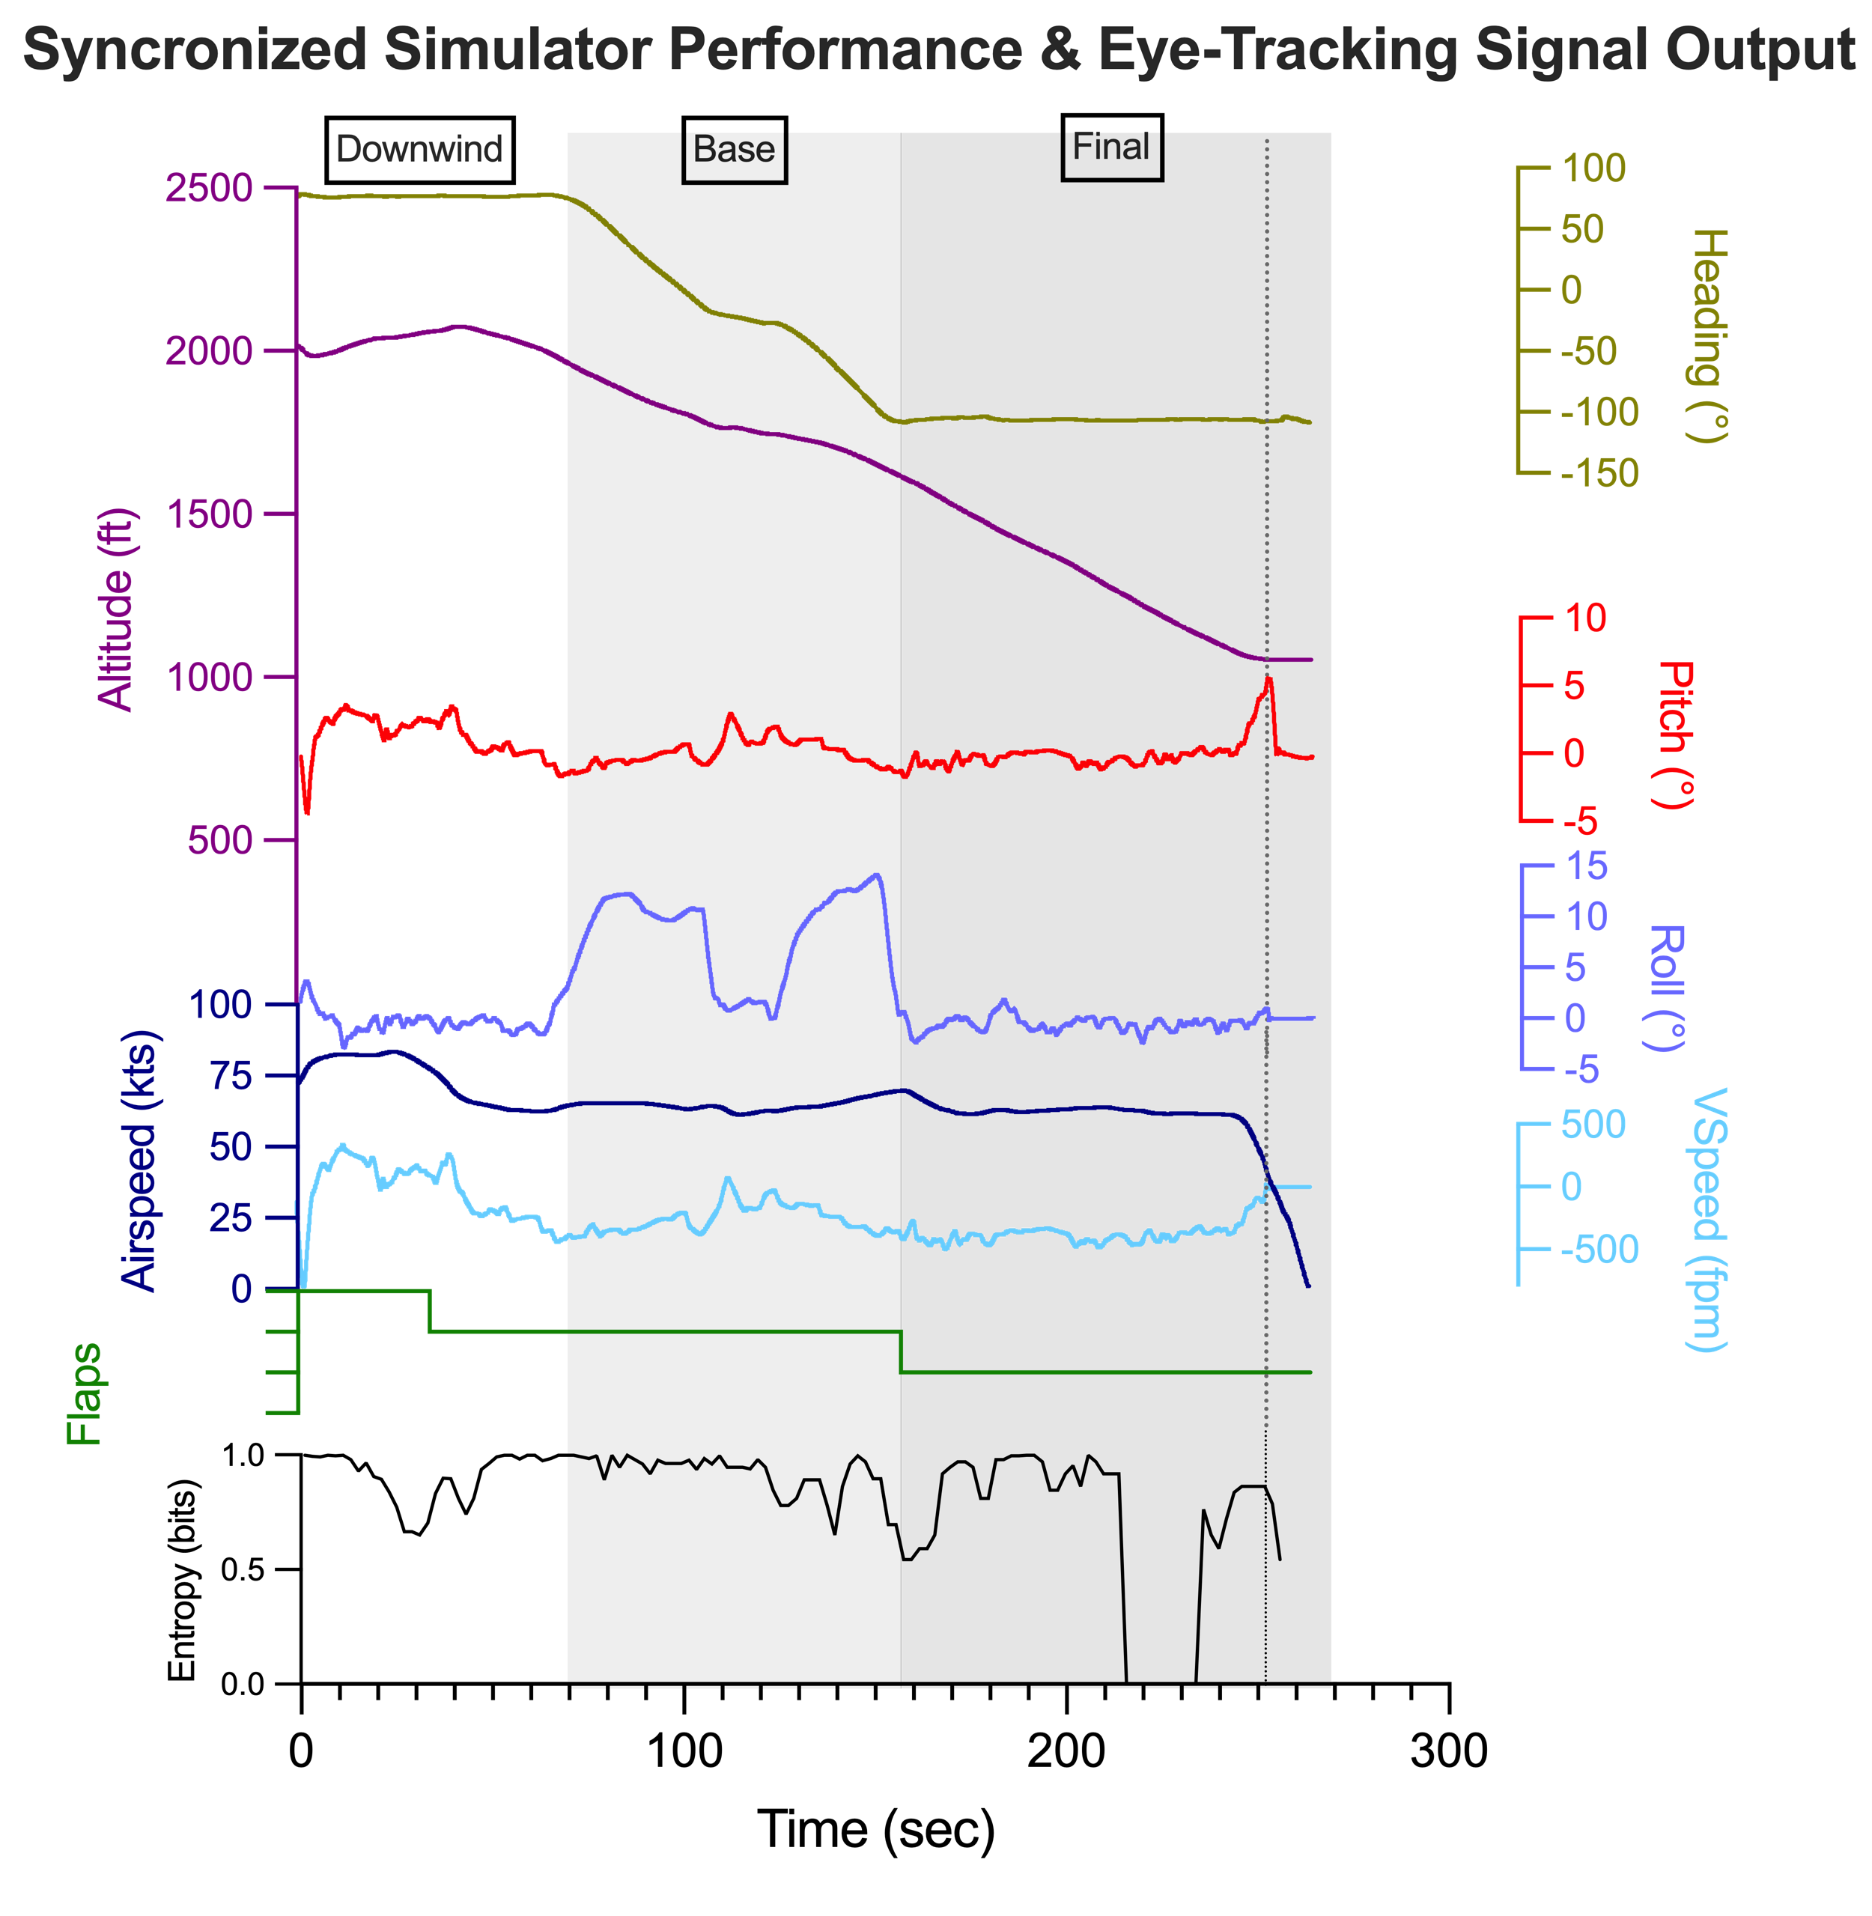
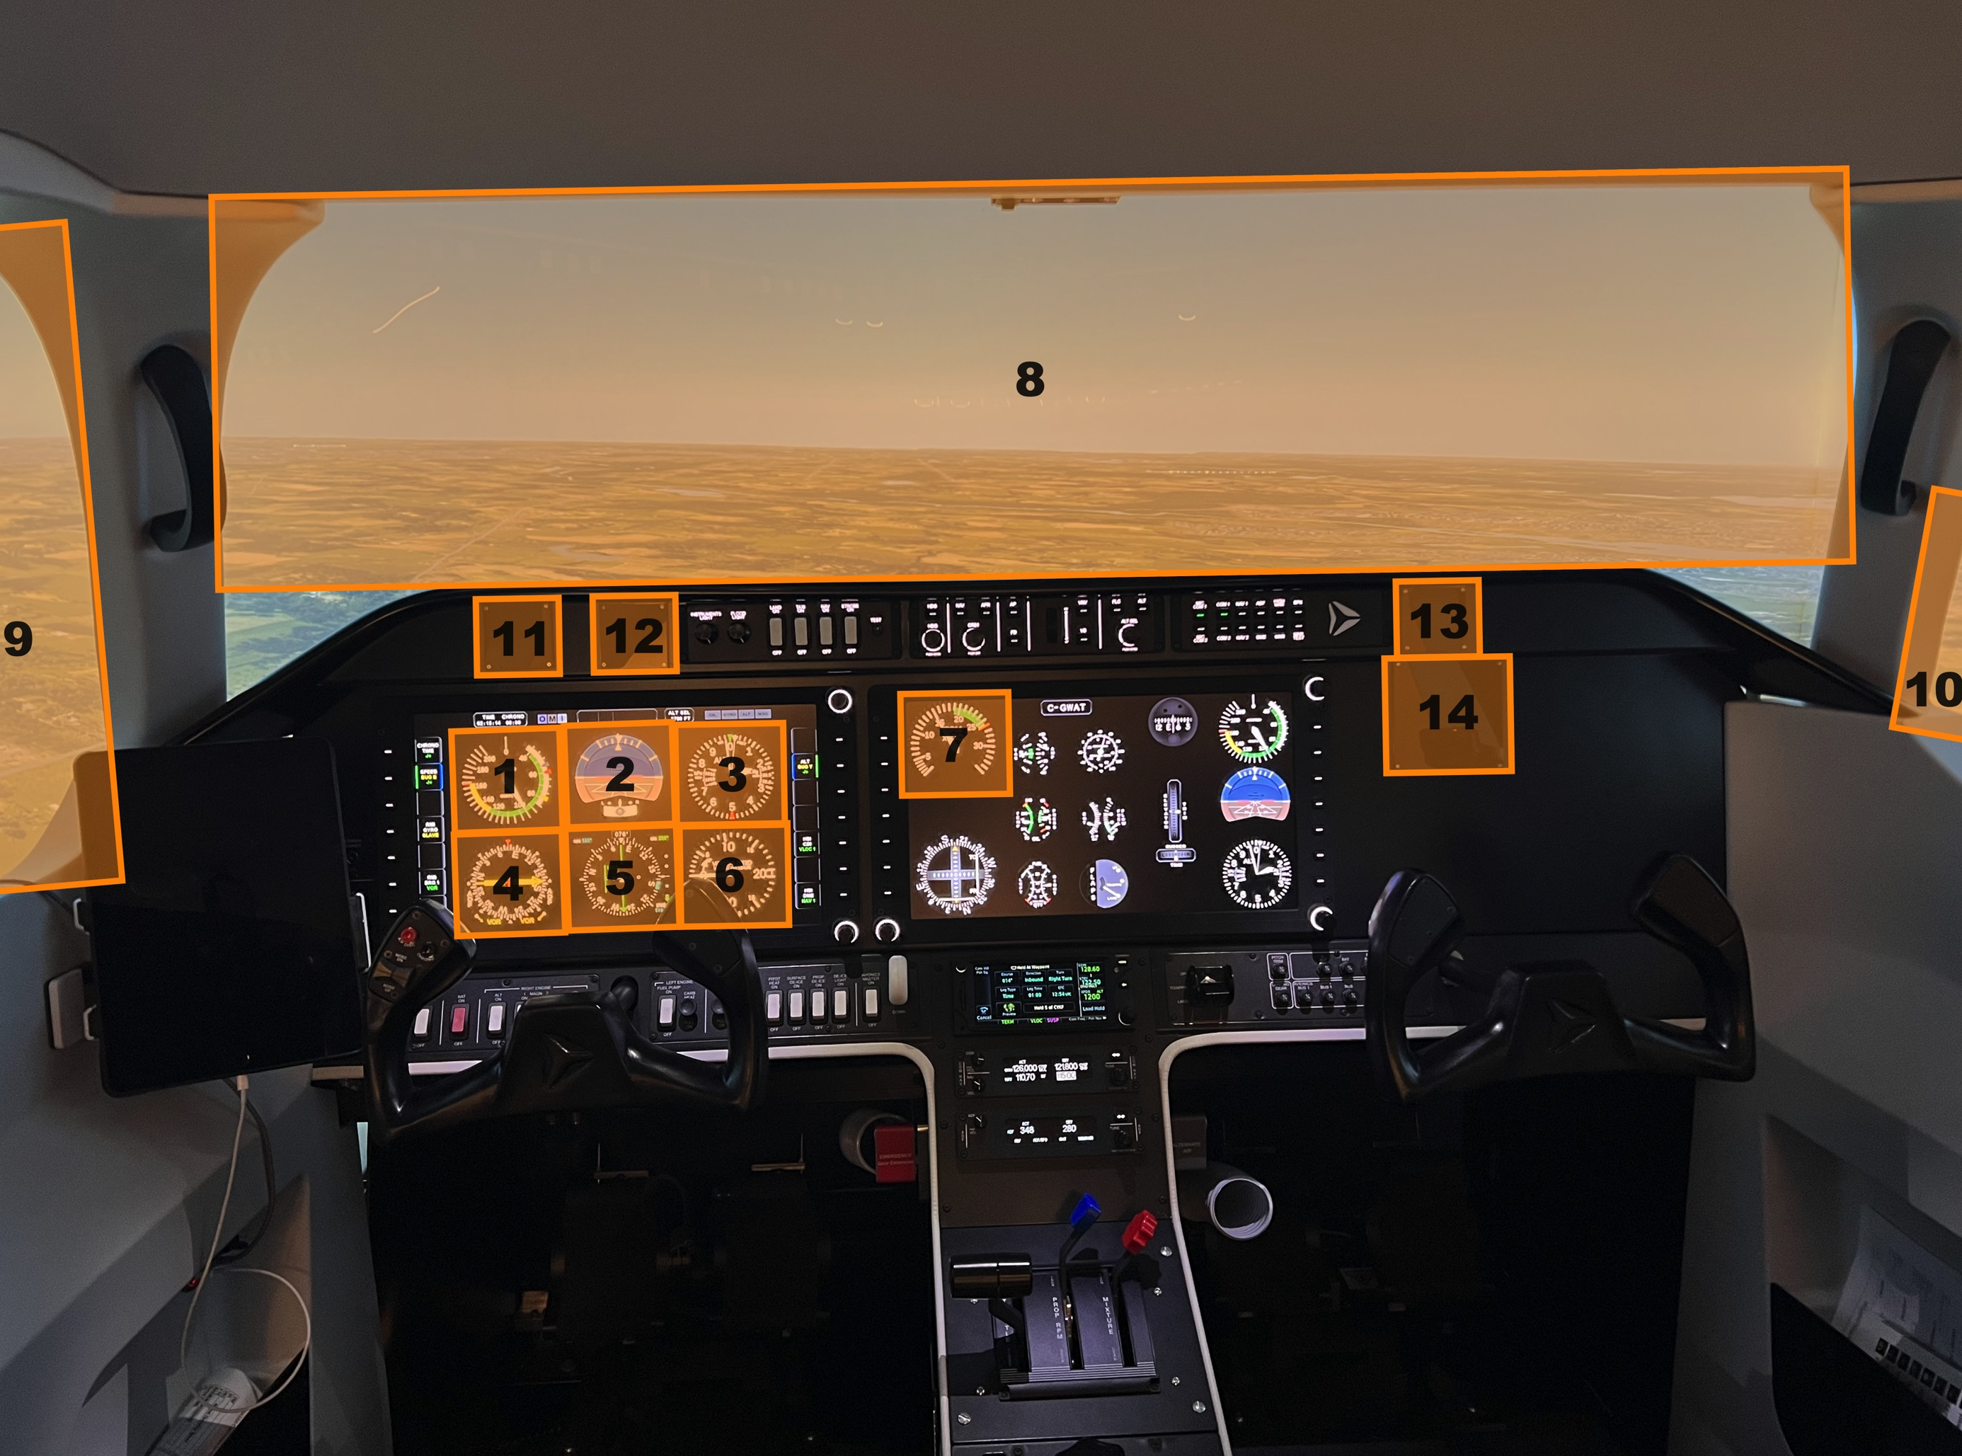
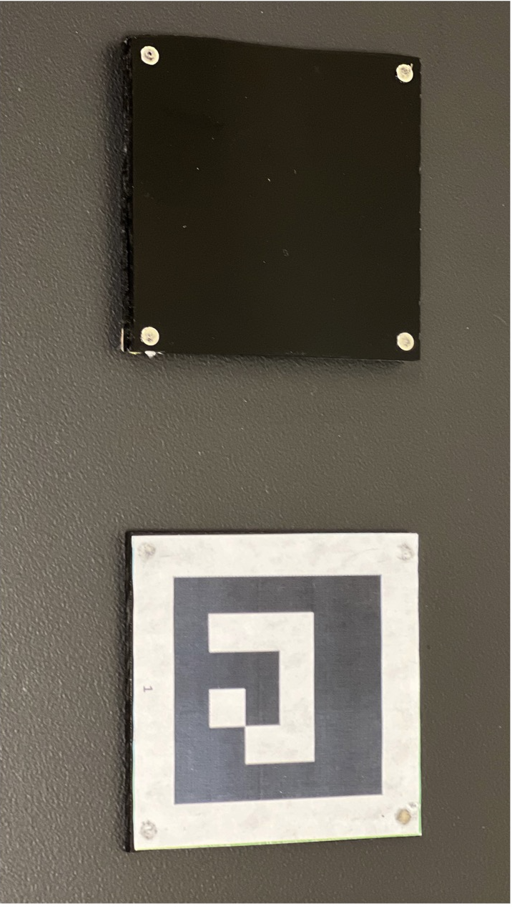
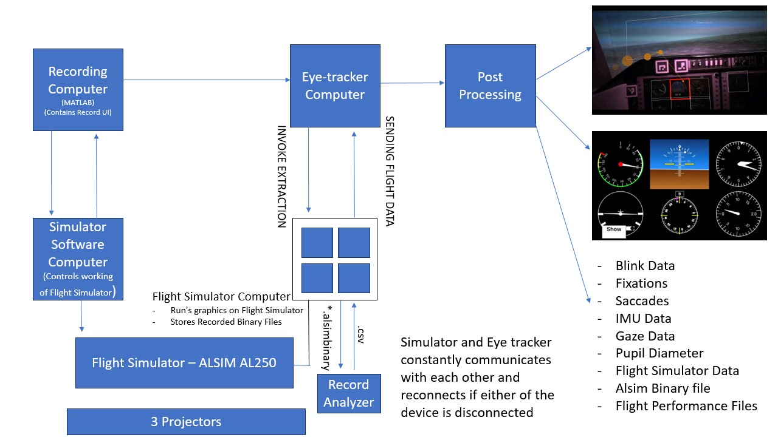
Development and implementation of non-intrusive eye tracking technology in a flight simulator: Building a robust collection and analytics pipeline
¹Ayala, N., ¹Sharma, N., ¹Zargari, S., ¹Martin Calderon, C., ³Mardanbegi, D., ²Duchowski, A., & ¹Niechwiej-Szwedo, E.
¹ University of Waterloo, Waterloo, ON, Canada; ² Clemson University, Clemson, SC, USA; ³ AdHawk Microsystems, Waterloo, ON, Canada
Background
Objectives & Conclusion
Simulators can aid in skill development and improve pilot training sustainability
Eye tracking provides insight into information processing and performance; thus, can be used to enhance pilot training outcomes
PROBLEM: inefficient approaches for signal collection and analysis have hindered the effectiveness and uptake of eye tracking in flight simulators
AIM: to develop a robust methodology for the effective implementation of an eye tracking system into a high-fidelity simulator
To create a standardized training manual for eye tracker setup and calibration in the flight simulator.
To implement temporal synchronization of the eye tracker with the simulator instrumentation.
To develop an analysis pipeline allowing extraction of gaze metrics including fixations, entropy and pupil dynamics related to scene Areas of Interest (AOIs), facilitated by fiducial markers.
CONCLUSION: Objectives 1&2 have been successfully achieved. We are currently working on optimizing objective 3 for the efficient processing of simulator and eye-tracking signal output
(a) Simulator environment with highlighted AOIs
(b) Fiducial markers

